Slide 1
Color-Magnitude Diagram For Globular Cluster M2
A Research Project by Dominic Elizondo

Slide 2
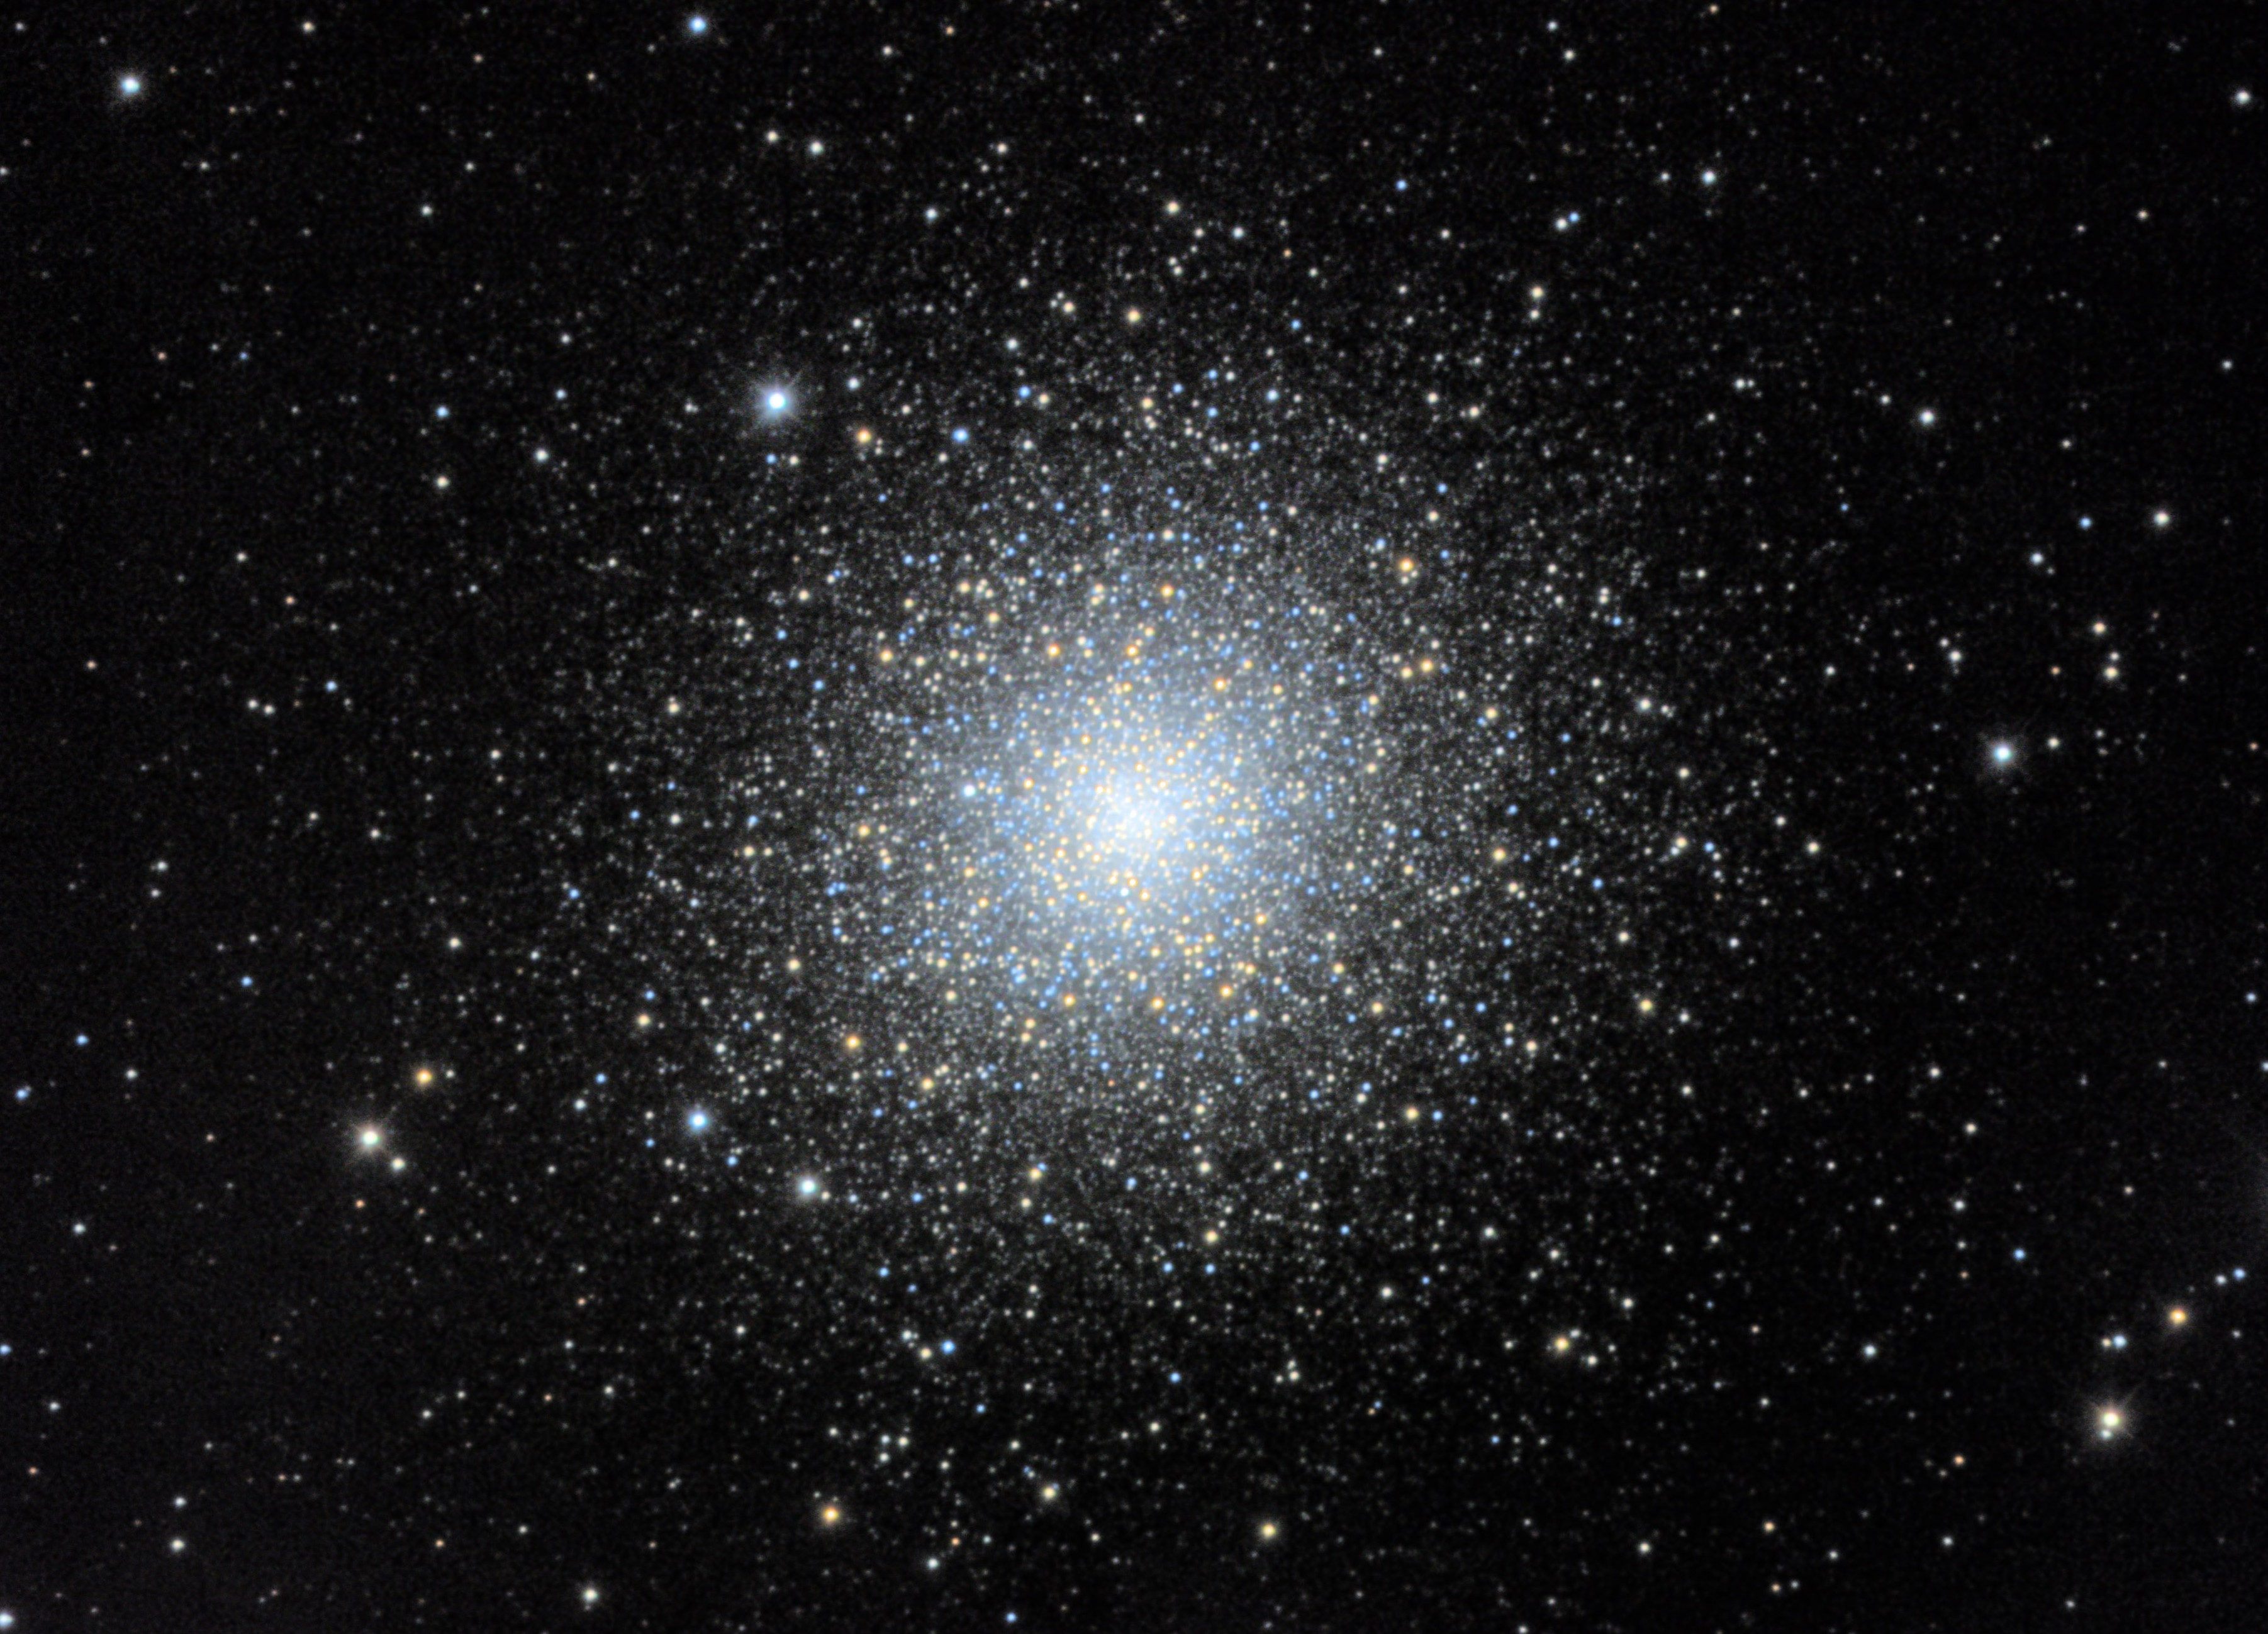
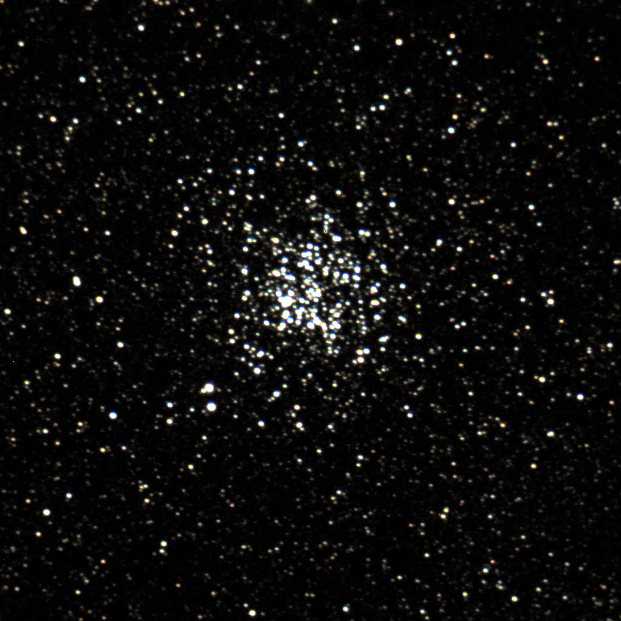
Contrasting Open and Globular Clusters
Age
Location
Number of Stars
M11 Open Cluster
M2 Globular Cluster

Slide 3
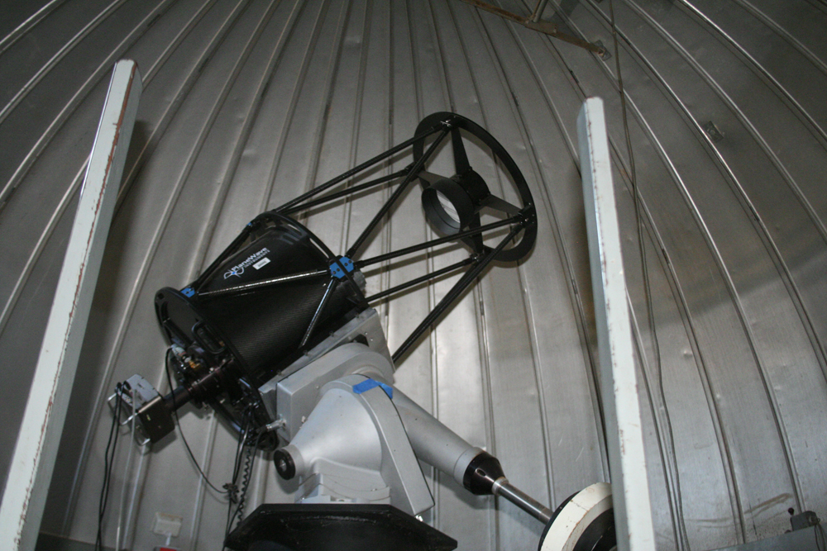
Data Collection
20’’ f/6.8 Plane Wave Cassegrain
SBIG STL-1001XE CCD Attached
20 Flats for B, V Filters Each
20 Flat Darks at Same Exposure Time
Science Darks at One Minute Exposure
15 Images Each with B and V Filters at Same Exposure

Slide 4
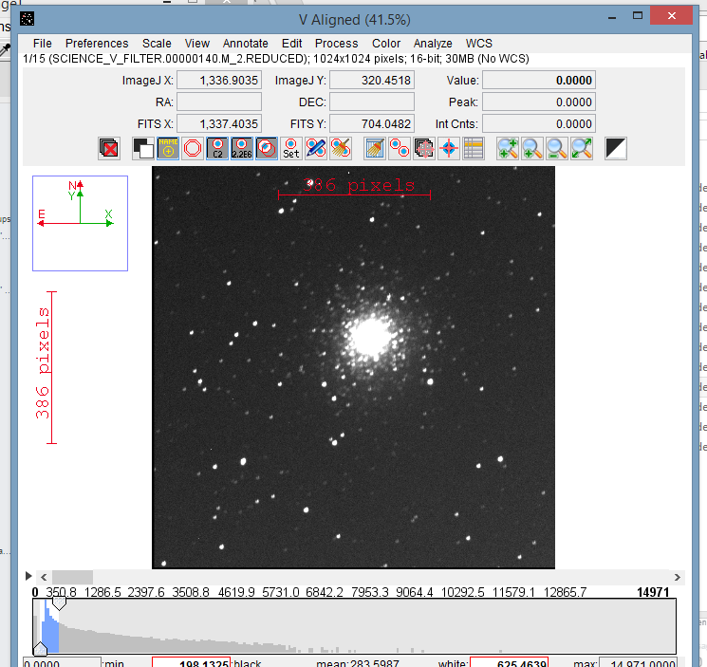
Data Reduction
CCDSoft
Reduce flats with flat darks
Create “Master Flat”
Combine Science Darks into “Master Dark”
Reduce Each Set of B and V Images with Both Masters
Align and Median Combine

Slide 5
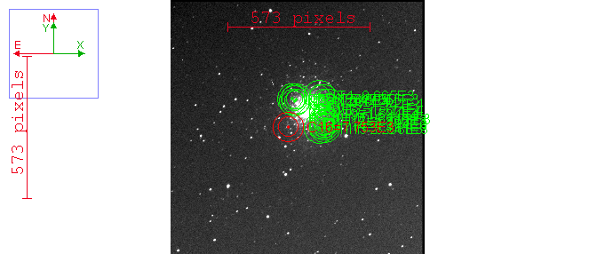
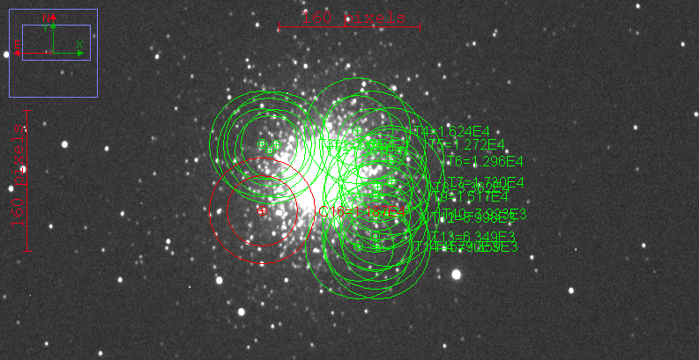
Data Analysis
AstroImageJ
Selected 15 Target Stars with One Reference Star for B Filter
Match These in V Filter
Collect Relative Flux (in Magnitudes) Data
V Filter
B Filter

Slide 6
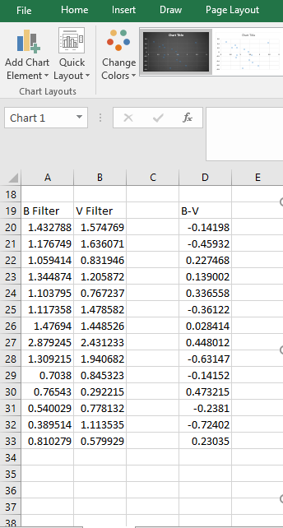
Data Analysis Cont.
B-V Data Column was Created From B and V Magnitudes
B-V Color was Plotted Against Magnitude in the V Filter

Slide 7
Conclusion
Main Sequence Detectable
Lower B-V is Redder and Brighter
Correlates with Knowledge of Globular Clusters

Slide 8
Conclusion
Main Sequence Detectable
Lower B-V is Redder and Brighter
Correlates with Knowledge of Globular Clusters
Questions?

